Slide 1


Figma
DATE :- 01/12/2023
PRESENTED BY
CHIRAG VISHVAKARMA
BCA FIRST YEAR
SUBMITTED TO
HOD
BCA DEPARTMENT

Slide 2
CONTENT
COLLABORATIVE DESIGN TOOL
2. FIGMA APP USER COMPANIES
3. SUPPORTED PLATEORMS
4. FREE FOR INDIVIDUAL USE
5. FIGMA ALTERATIVES

Slide 3
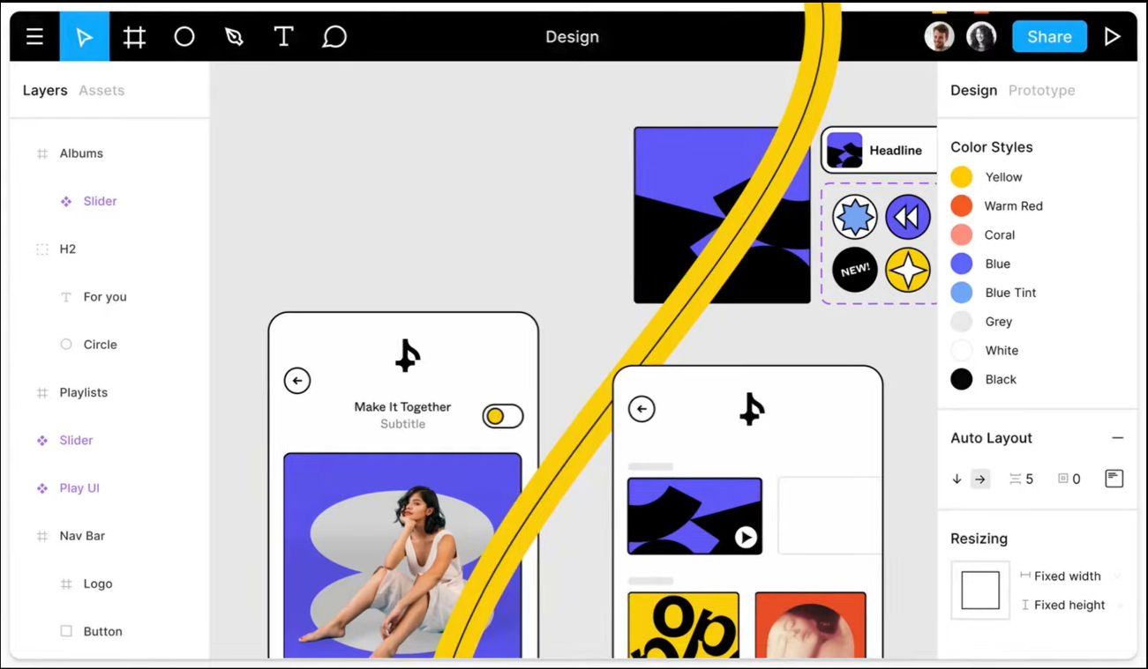
COLLABORATIVE DESIGN TOOL

Slide 4




FIGMA APP USER COMPANIES
There are some companies that use Figma

Slide 5
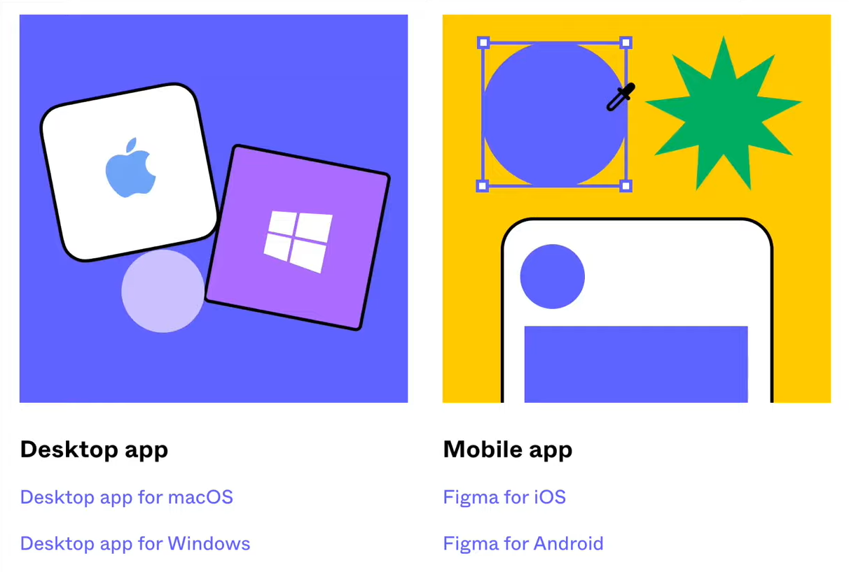
SUPPORTED PLATEORMS

Slide 6
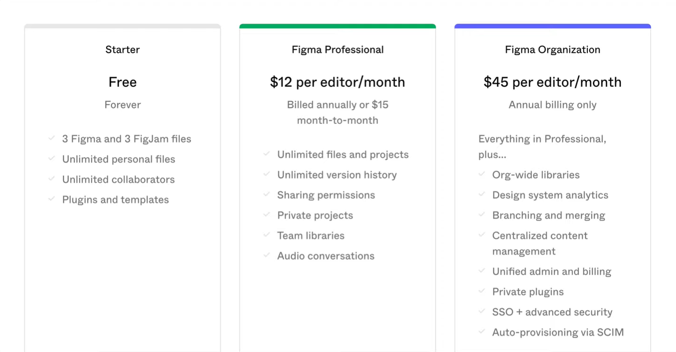
FREE FOR INDIVIDUAL USE

Slide 7
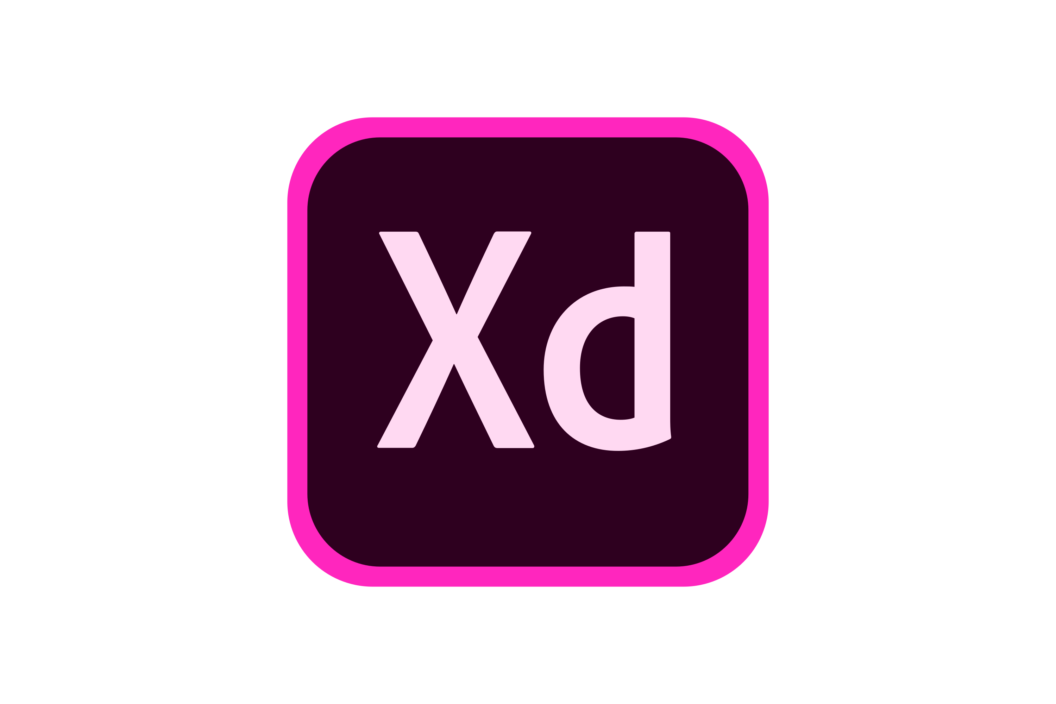


FIGMA ALTERATIVES
ADOBE XD
SKETCH
FRAMER

Slide 8
ADOBE XD
Adobe XD was created by Adobe Inc.
Part of the Adobe XD Creative Suite
It is a good tool for UI design

Slide 9
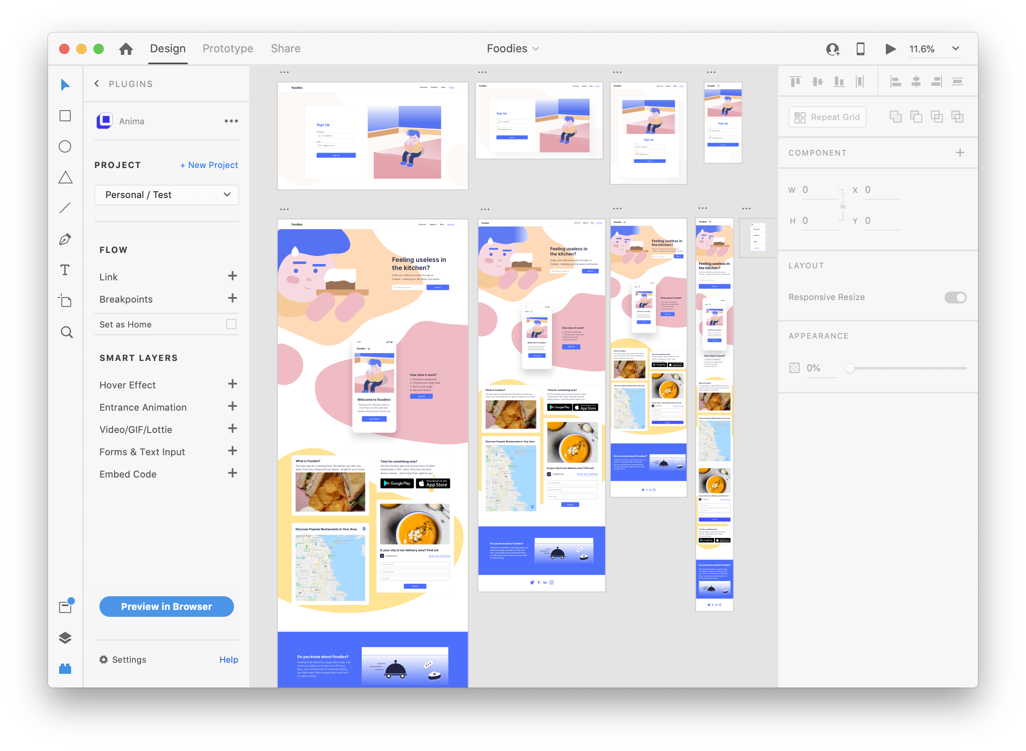
ADOBE XD APP

Slide 10
SKETCH
This come only for mac.
This app works on desktop.

Slide 11
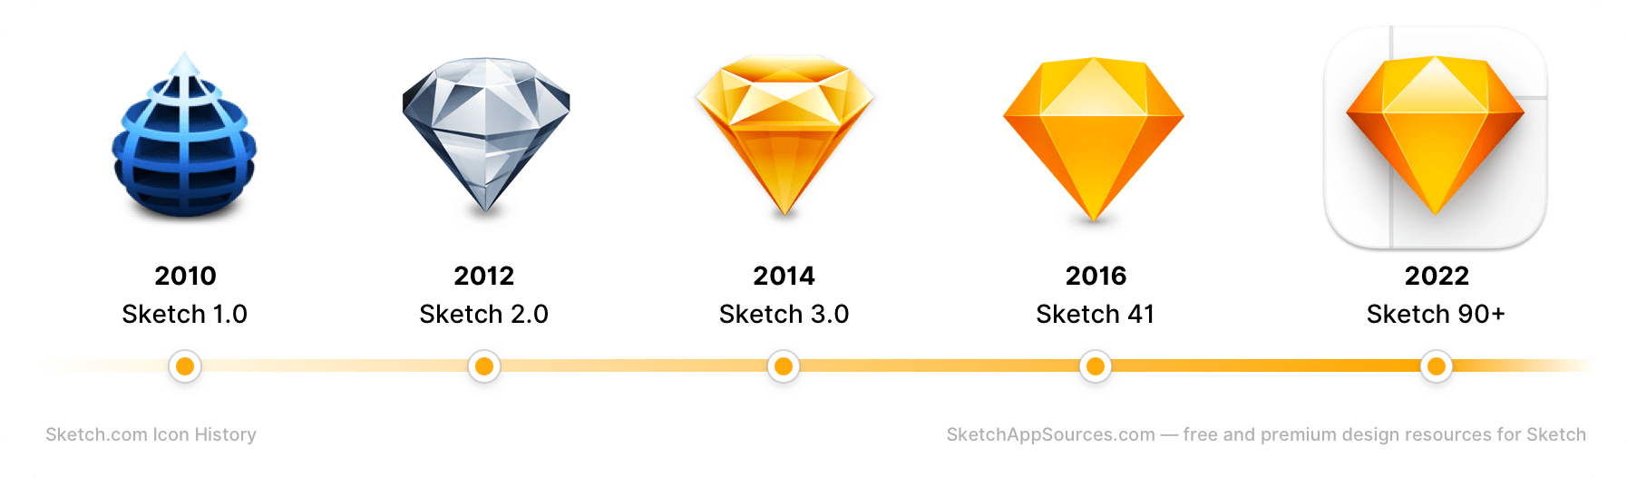
SKETCH APP

Slide 12
FRAMER
Framer app was launched in 2016.
The Framer app work just like Figma.
And this app is perfect for learning.

Slide 13
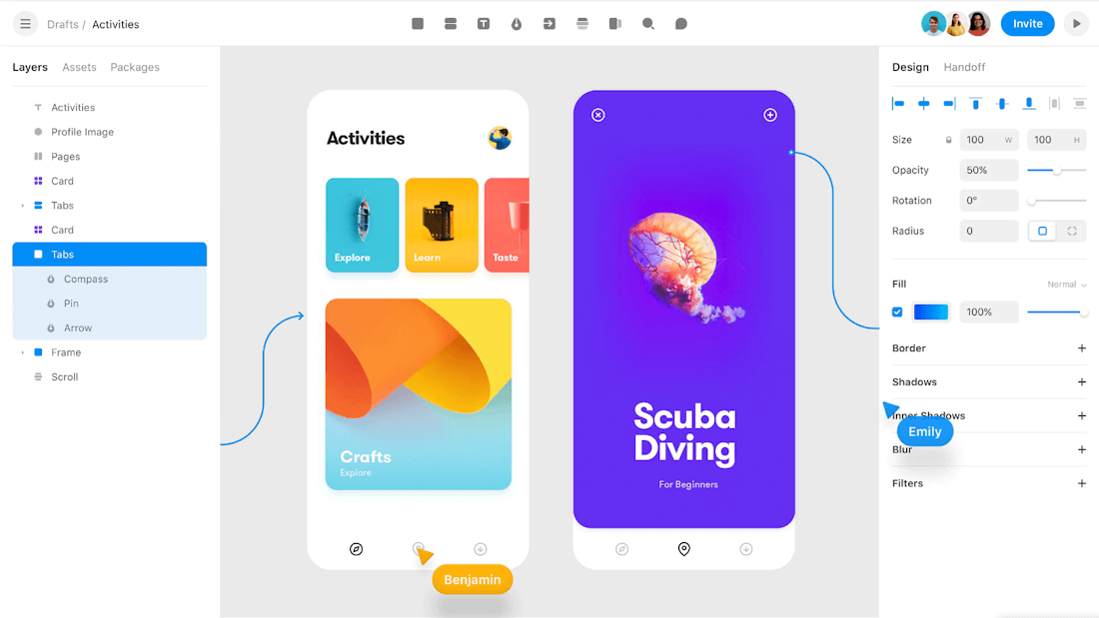
FRAMER APP

Slide 14
Thank You

